Slide 1
Numpy
Reference:
Apress – Numerical Python, Robert Johansson, Chapter 2, 2015

Slide 2
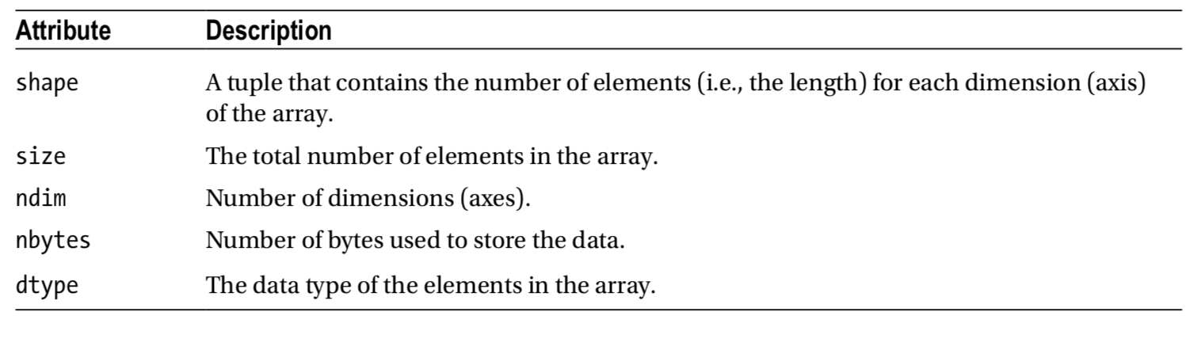
Numpy array object

Slide 3
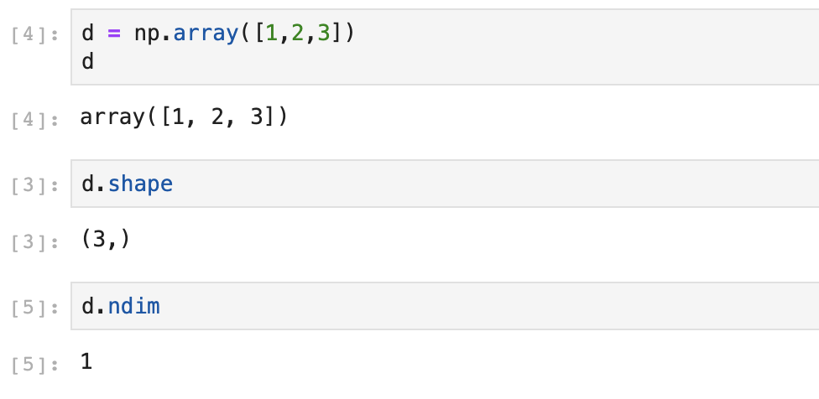
1-d array

Slide 4
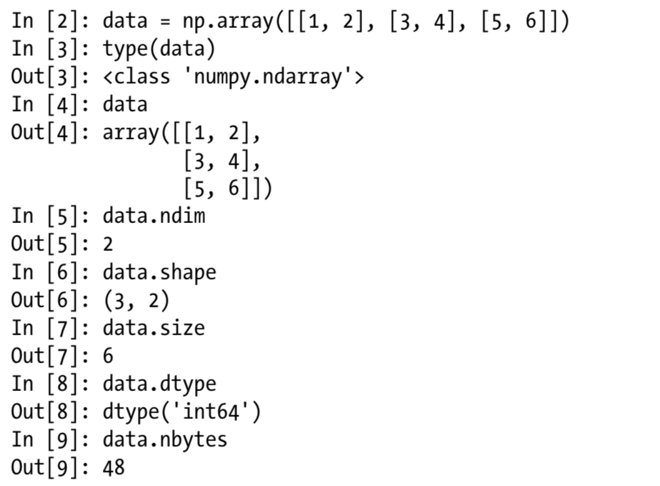
Create array from nested list

Slide 5
Create array
np.full()
np.empty()
np.ones()
np.zeros()
np.linspace()
x = [-1, 0, 1]
y = [-2, 0, 2]
X,Y = np.meshgrid(x,y)
They can take a dimension tuple
They can take a datatype
Sometimes, you can supply a value to fill
start point, inclusive
end point, inclusive
# of data point to populate
-

Slide 6
Create array with properties (shape) of other arrays
np.zeros_like()
np.full_like()
np.ones_lie()

Slide 7
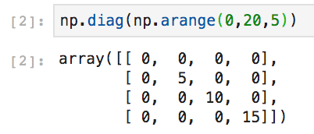
Create matrix array
np.identity()
np.eye()
np.diag()

Slide 8
Indexing and Slicing
One dimensional or Multi-dimensional
select single row
select single column
select submatrix
select based on stride

Slide 9
Indexing
From: Apress – Numerical Python, 2015

Slide 10
Reshape/Resize

Slide 11
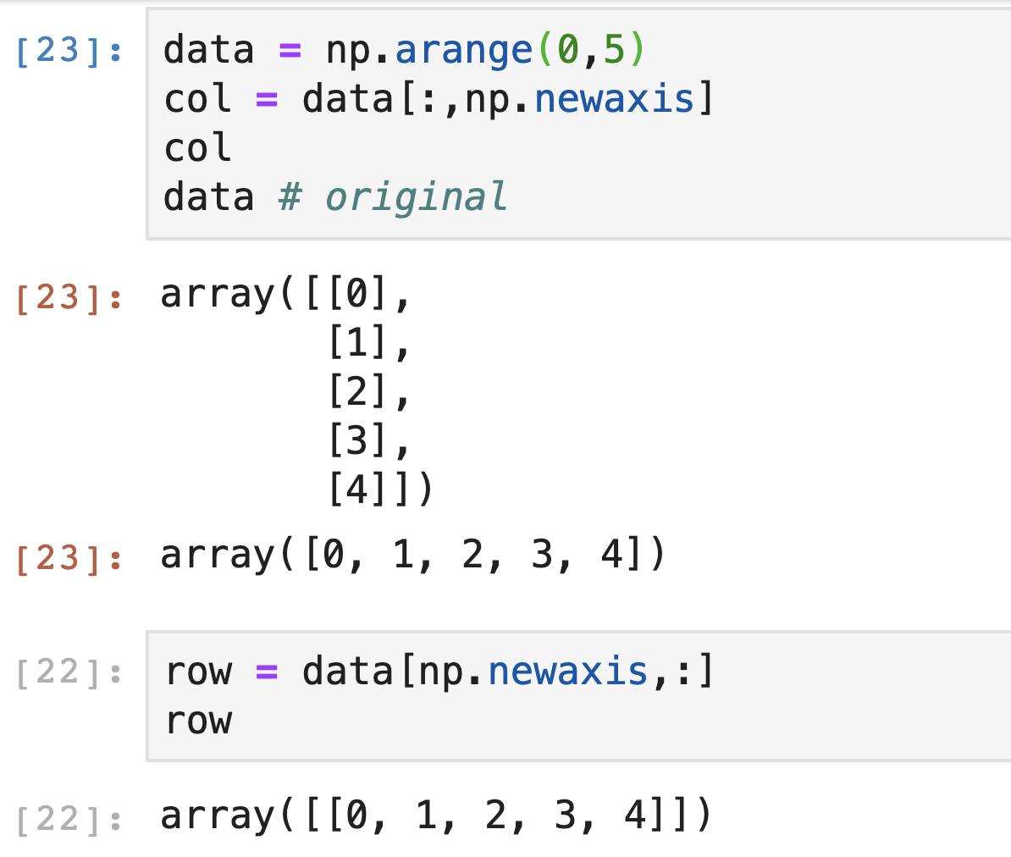
Add new axis: np.newaxis
new axis is added axis = 0
new axis is added axis = 1

Slide 12
Remove dimension: np.ravel and np.flatten
np.ravel() is a special case of reshape, which collapses all dimensions of an array and returns a flattened one–dimension array with length that corresponds to the total number of elements in the original array.
np.flatten() performs the same function, but returns a copy instead of a view.

Slide 13
Broadcasting Rule
An array can be broadcasted over another array if their axes on a one-by-one basis
either have the same length
either of them have length of 1
If the number of axes of the two arrays is not equal, then the array with fewer axes is padded with new axes of length 1 from the left until the number of dimension of two arrays agree.

Slide 14
Broadcast example: mapping (1,2) -> (2,2)
x = np.array([1,2,3,4]).reshape(2,2)

Slide 15
Broadcast example: mapping (2,1) -> (2,2)

Slide 16
Aggregate functions

Slide 17
Aggregate function with axis control

Slide 18
Visual example

Slide 19
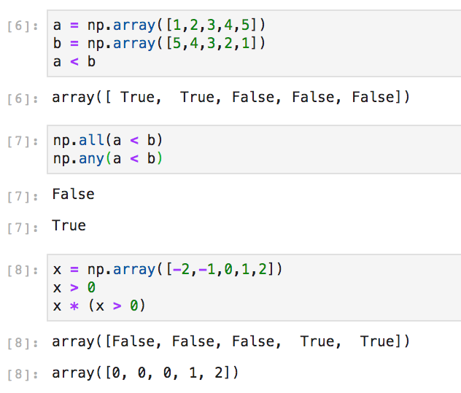
Boolean Array and Conditional Expression

Slide 20
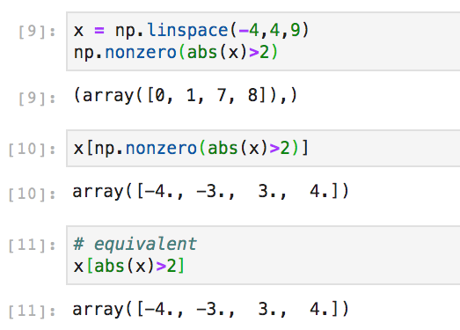
np.non_zeros: return array of indices of non-zero elements

Slide 21
Matrix operation
Compare to:

